Slide 1



Slide 2



Slide 3
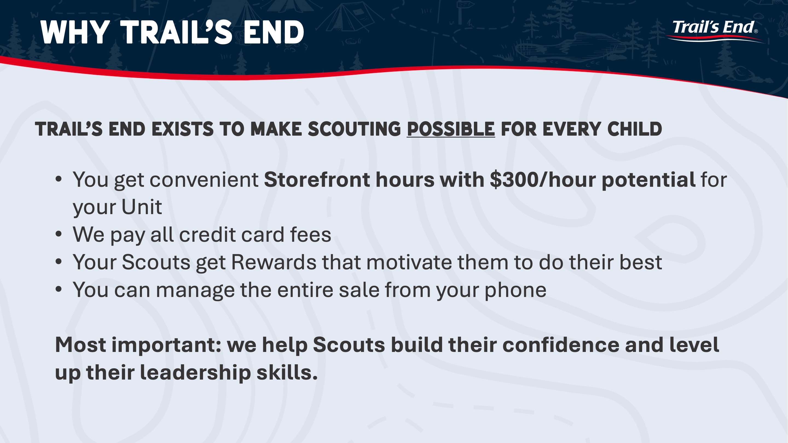

Slide 4




Slide 5


Slide 6
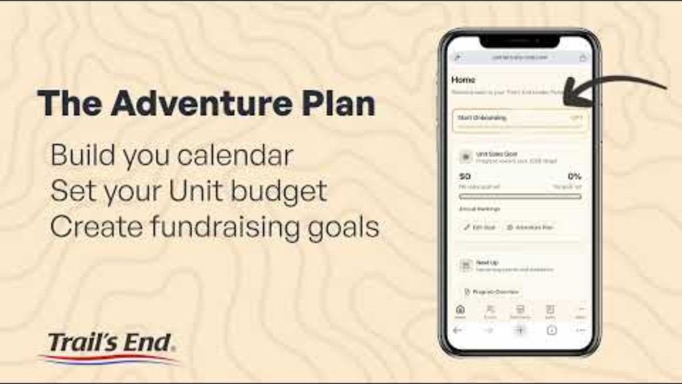


Slide 7
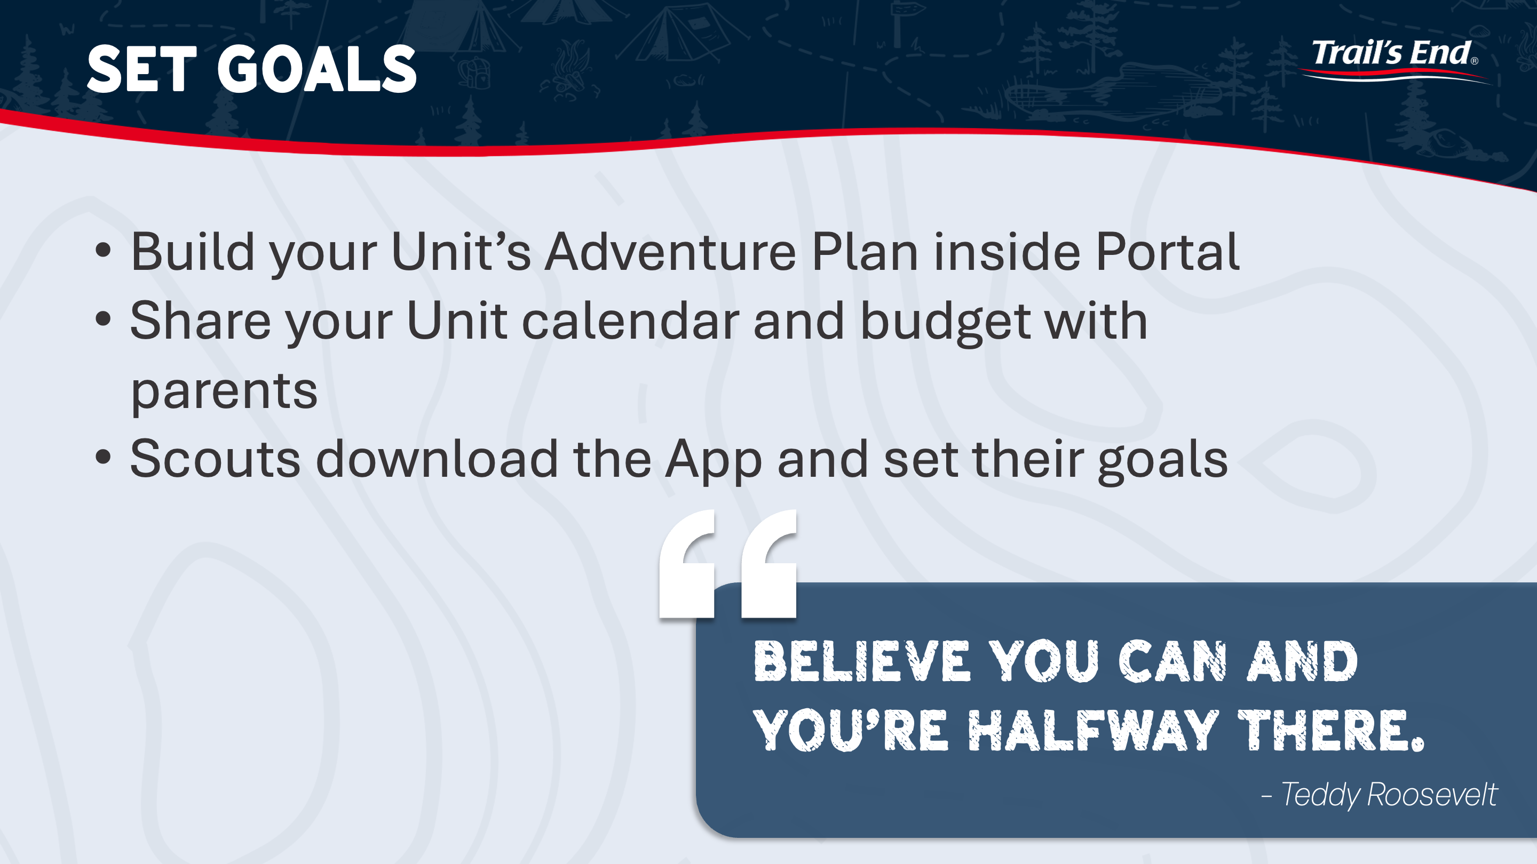

Slide 8
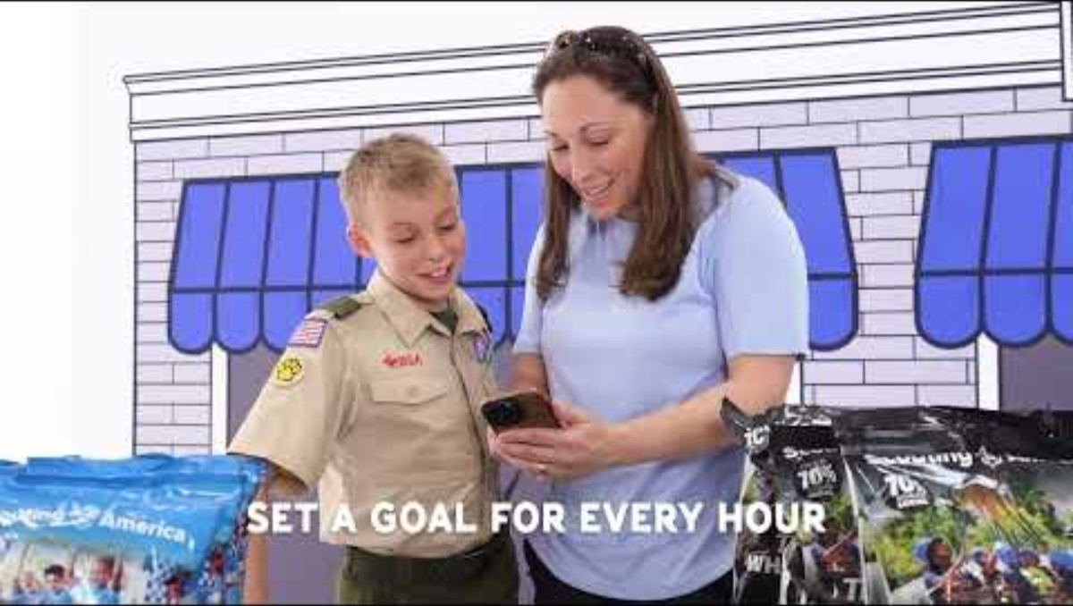


Slide 9
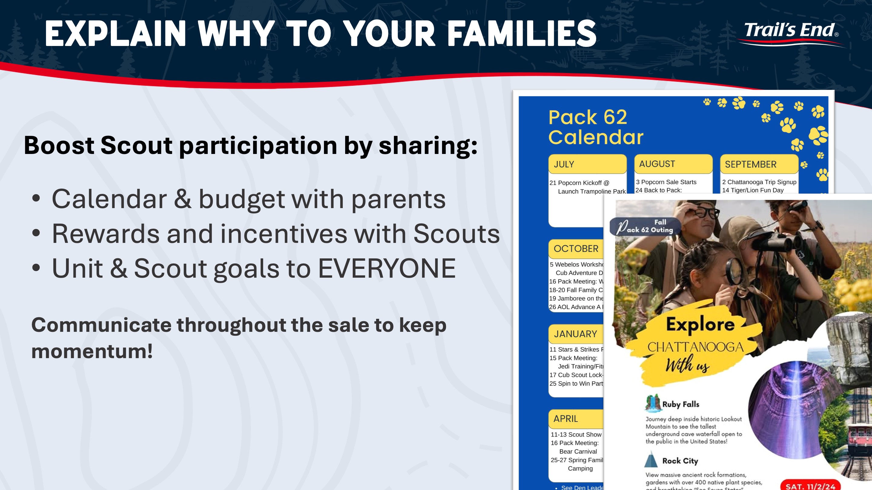

Slide 10



Slide 13
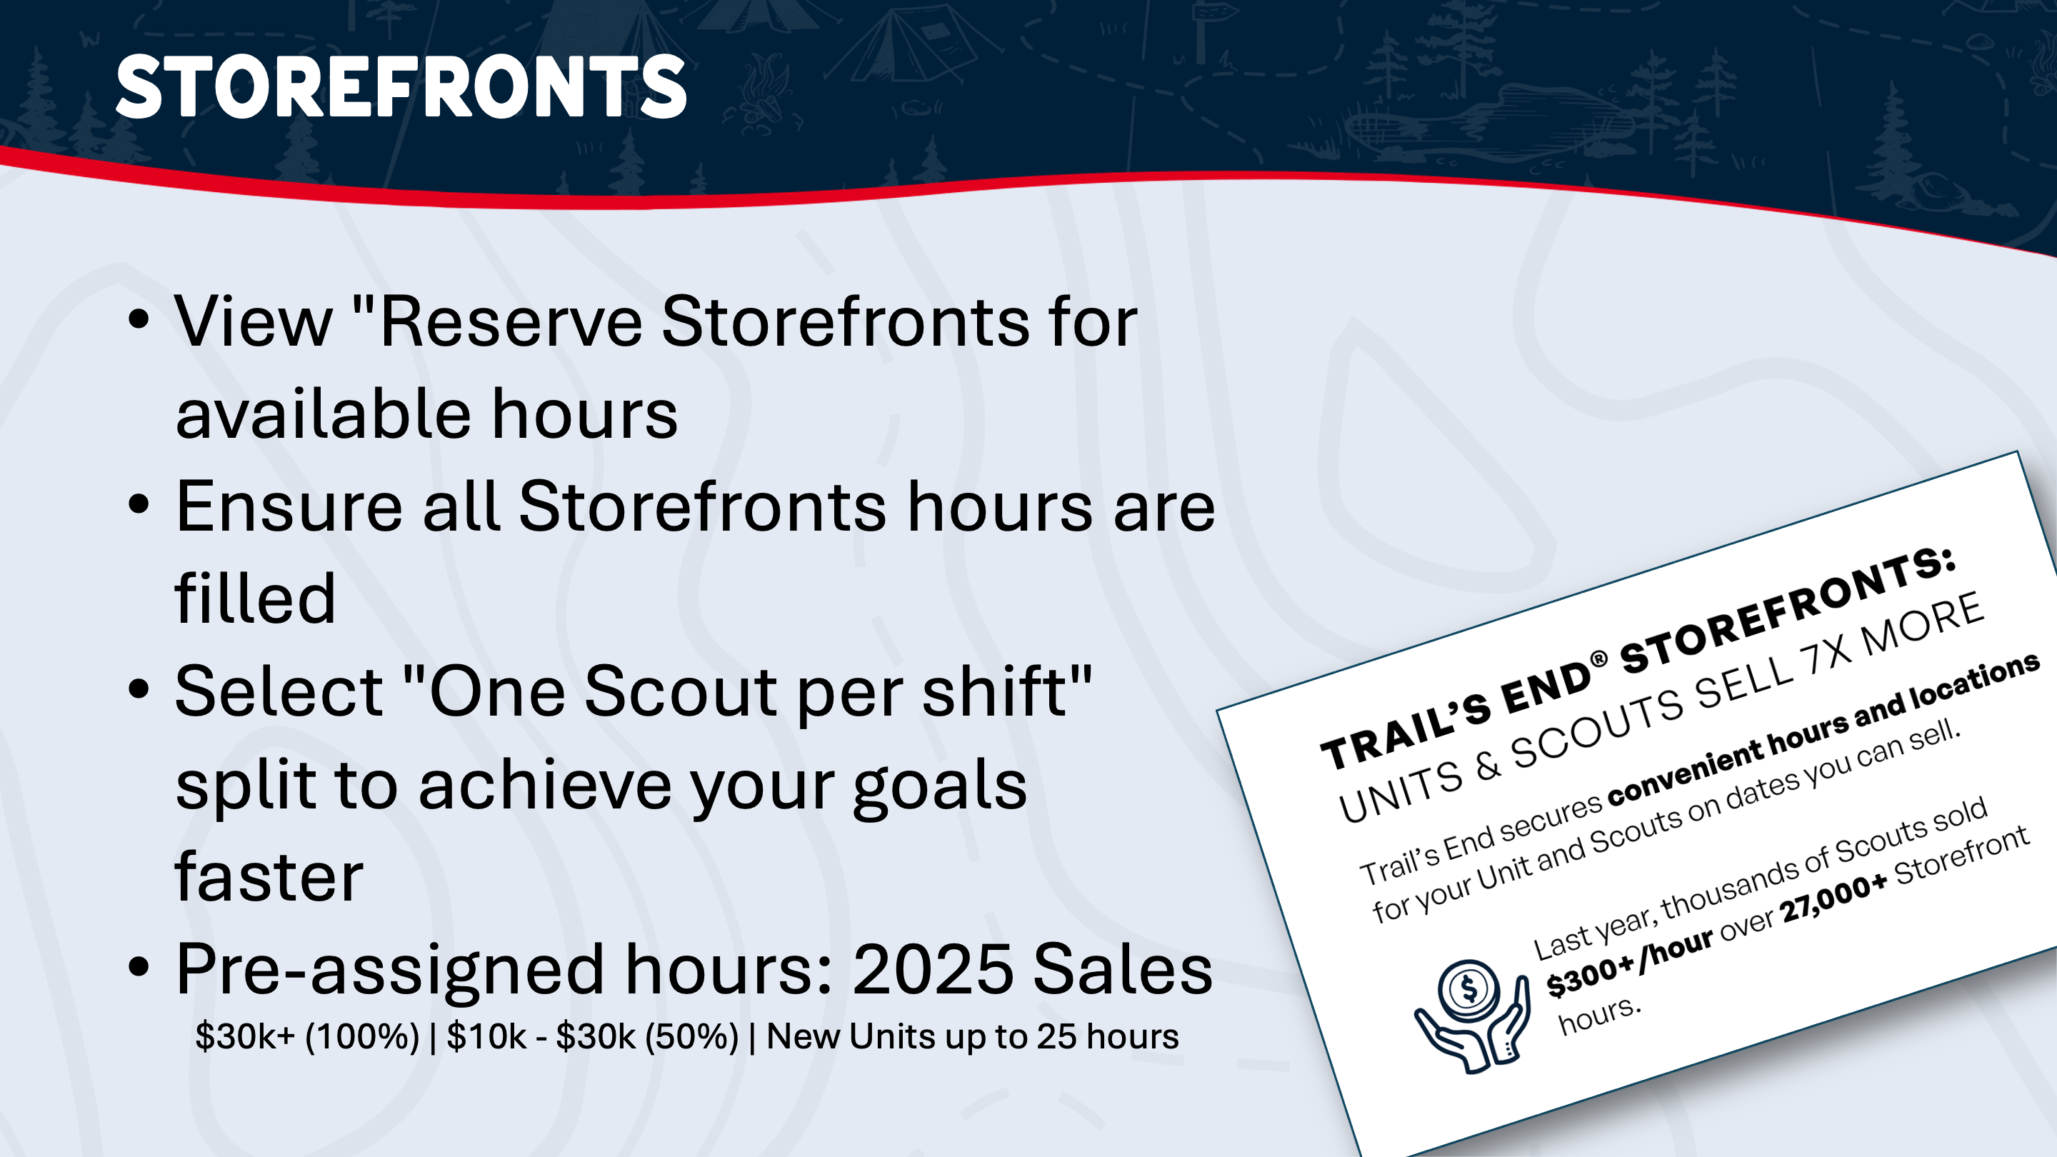

Slide 14


Slide 15
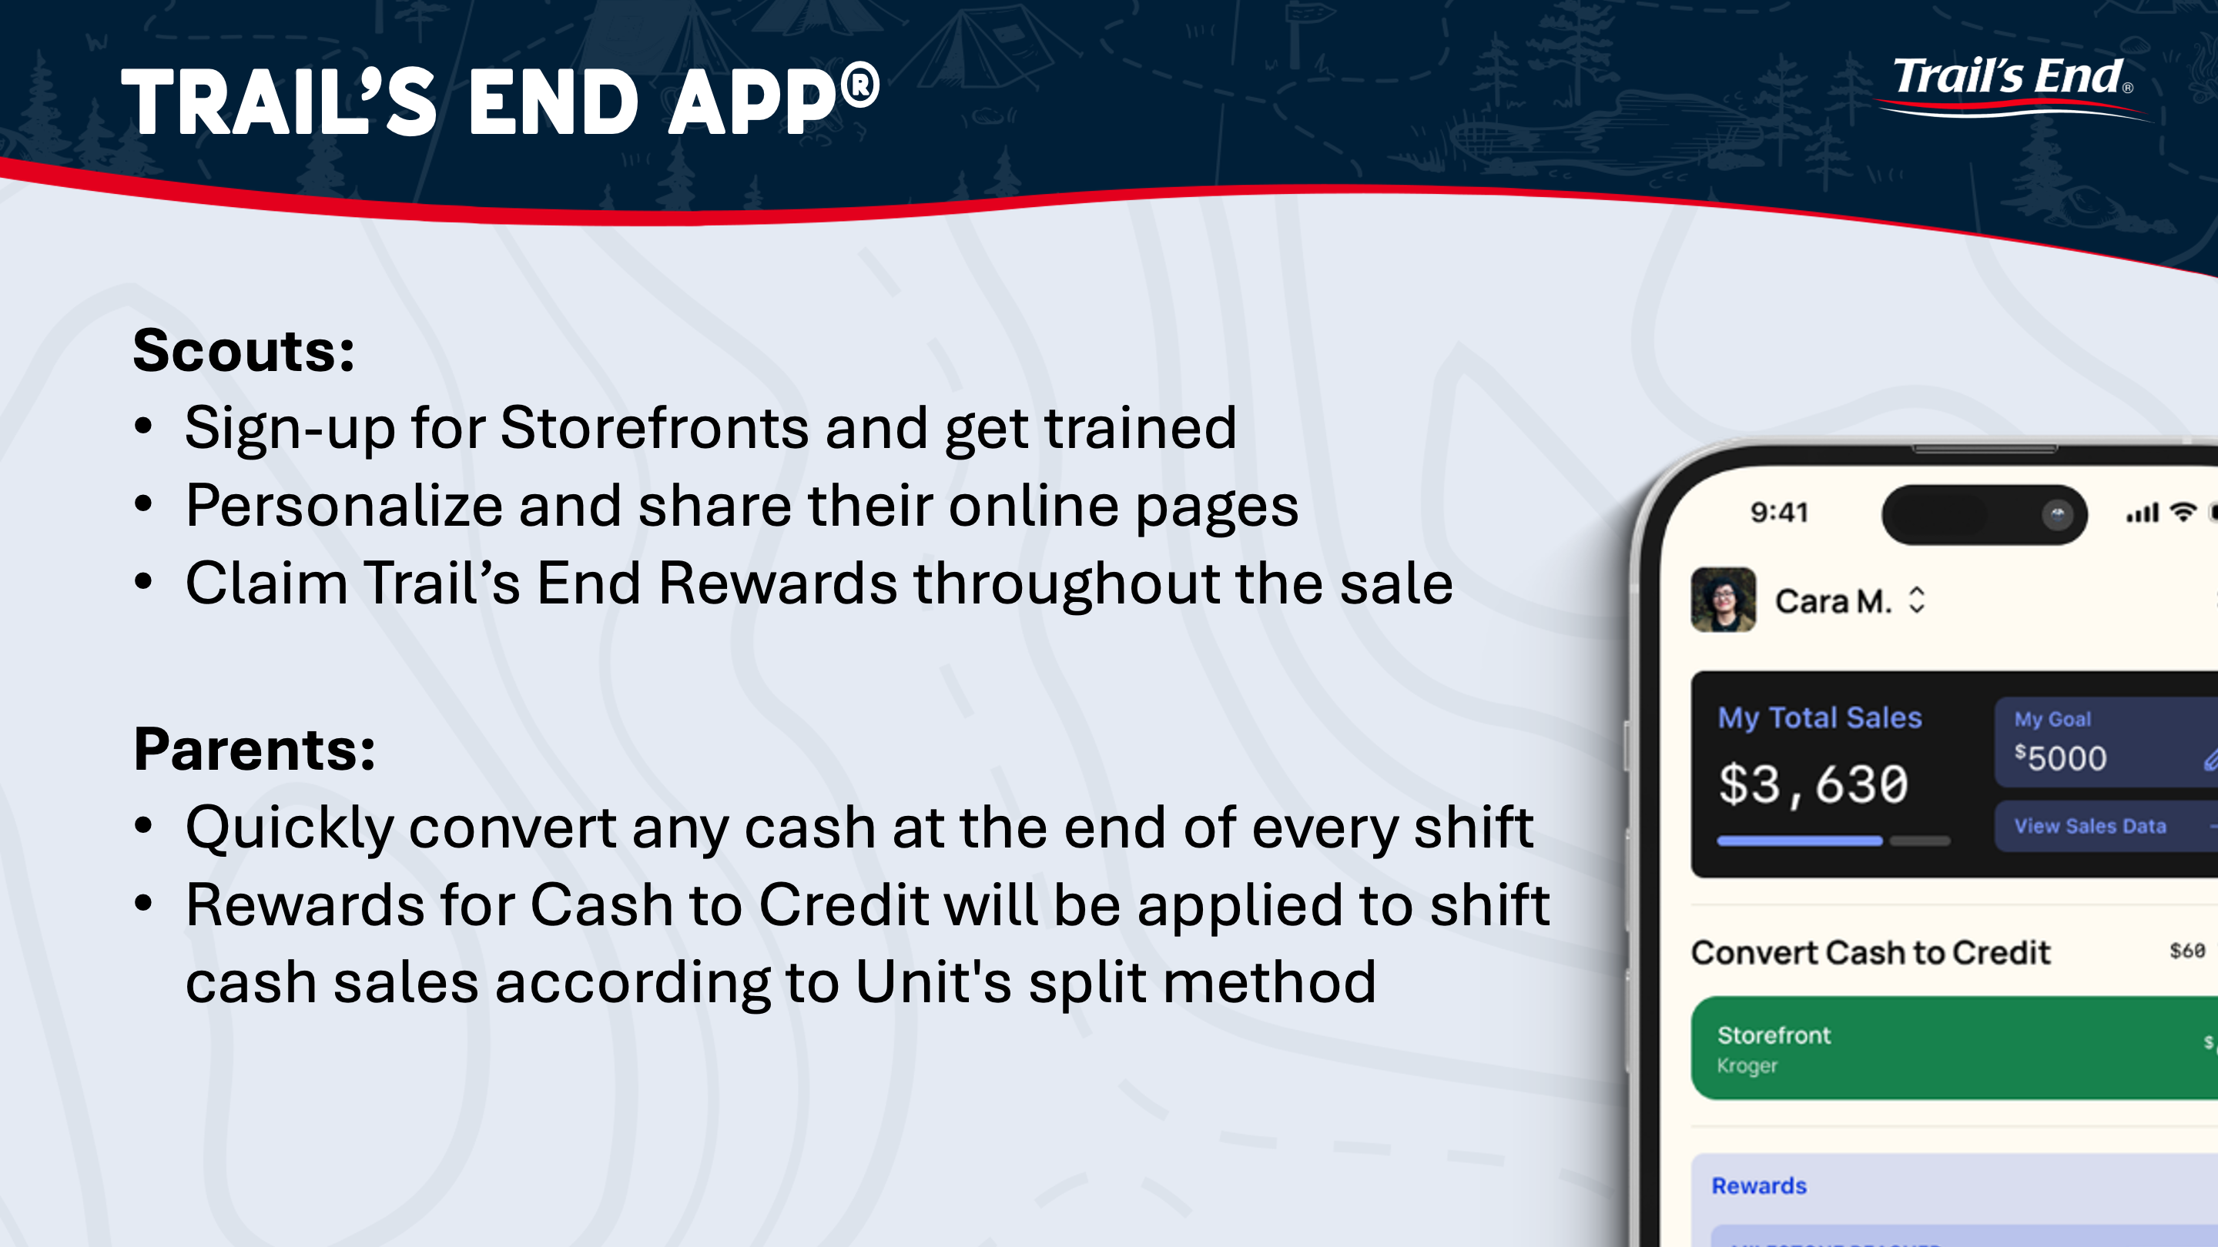

Slide 16


Slide 17


Slide 18


Slide 19


Slide 20
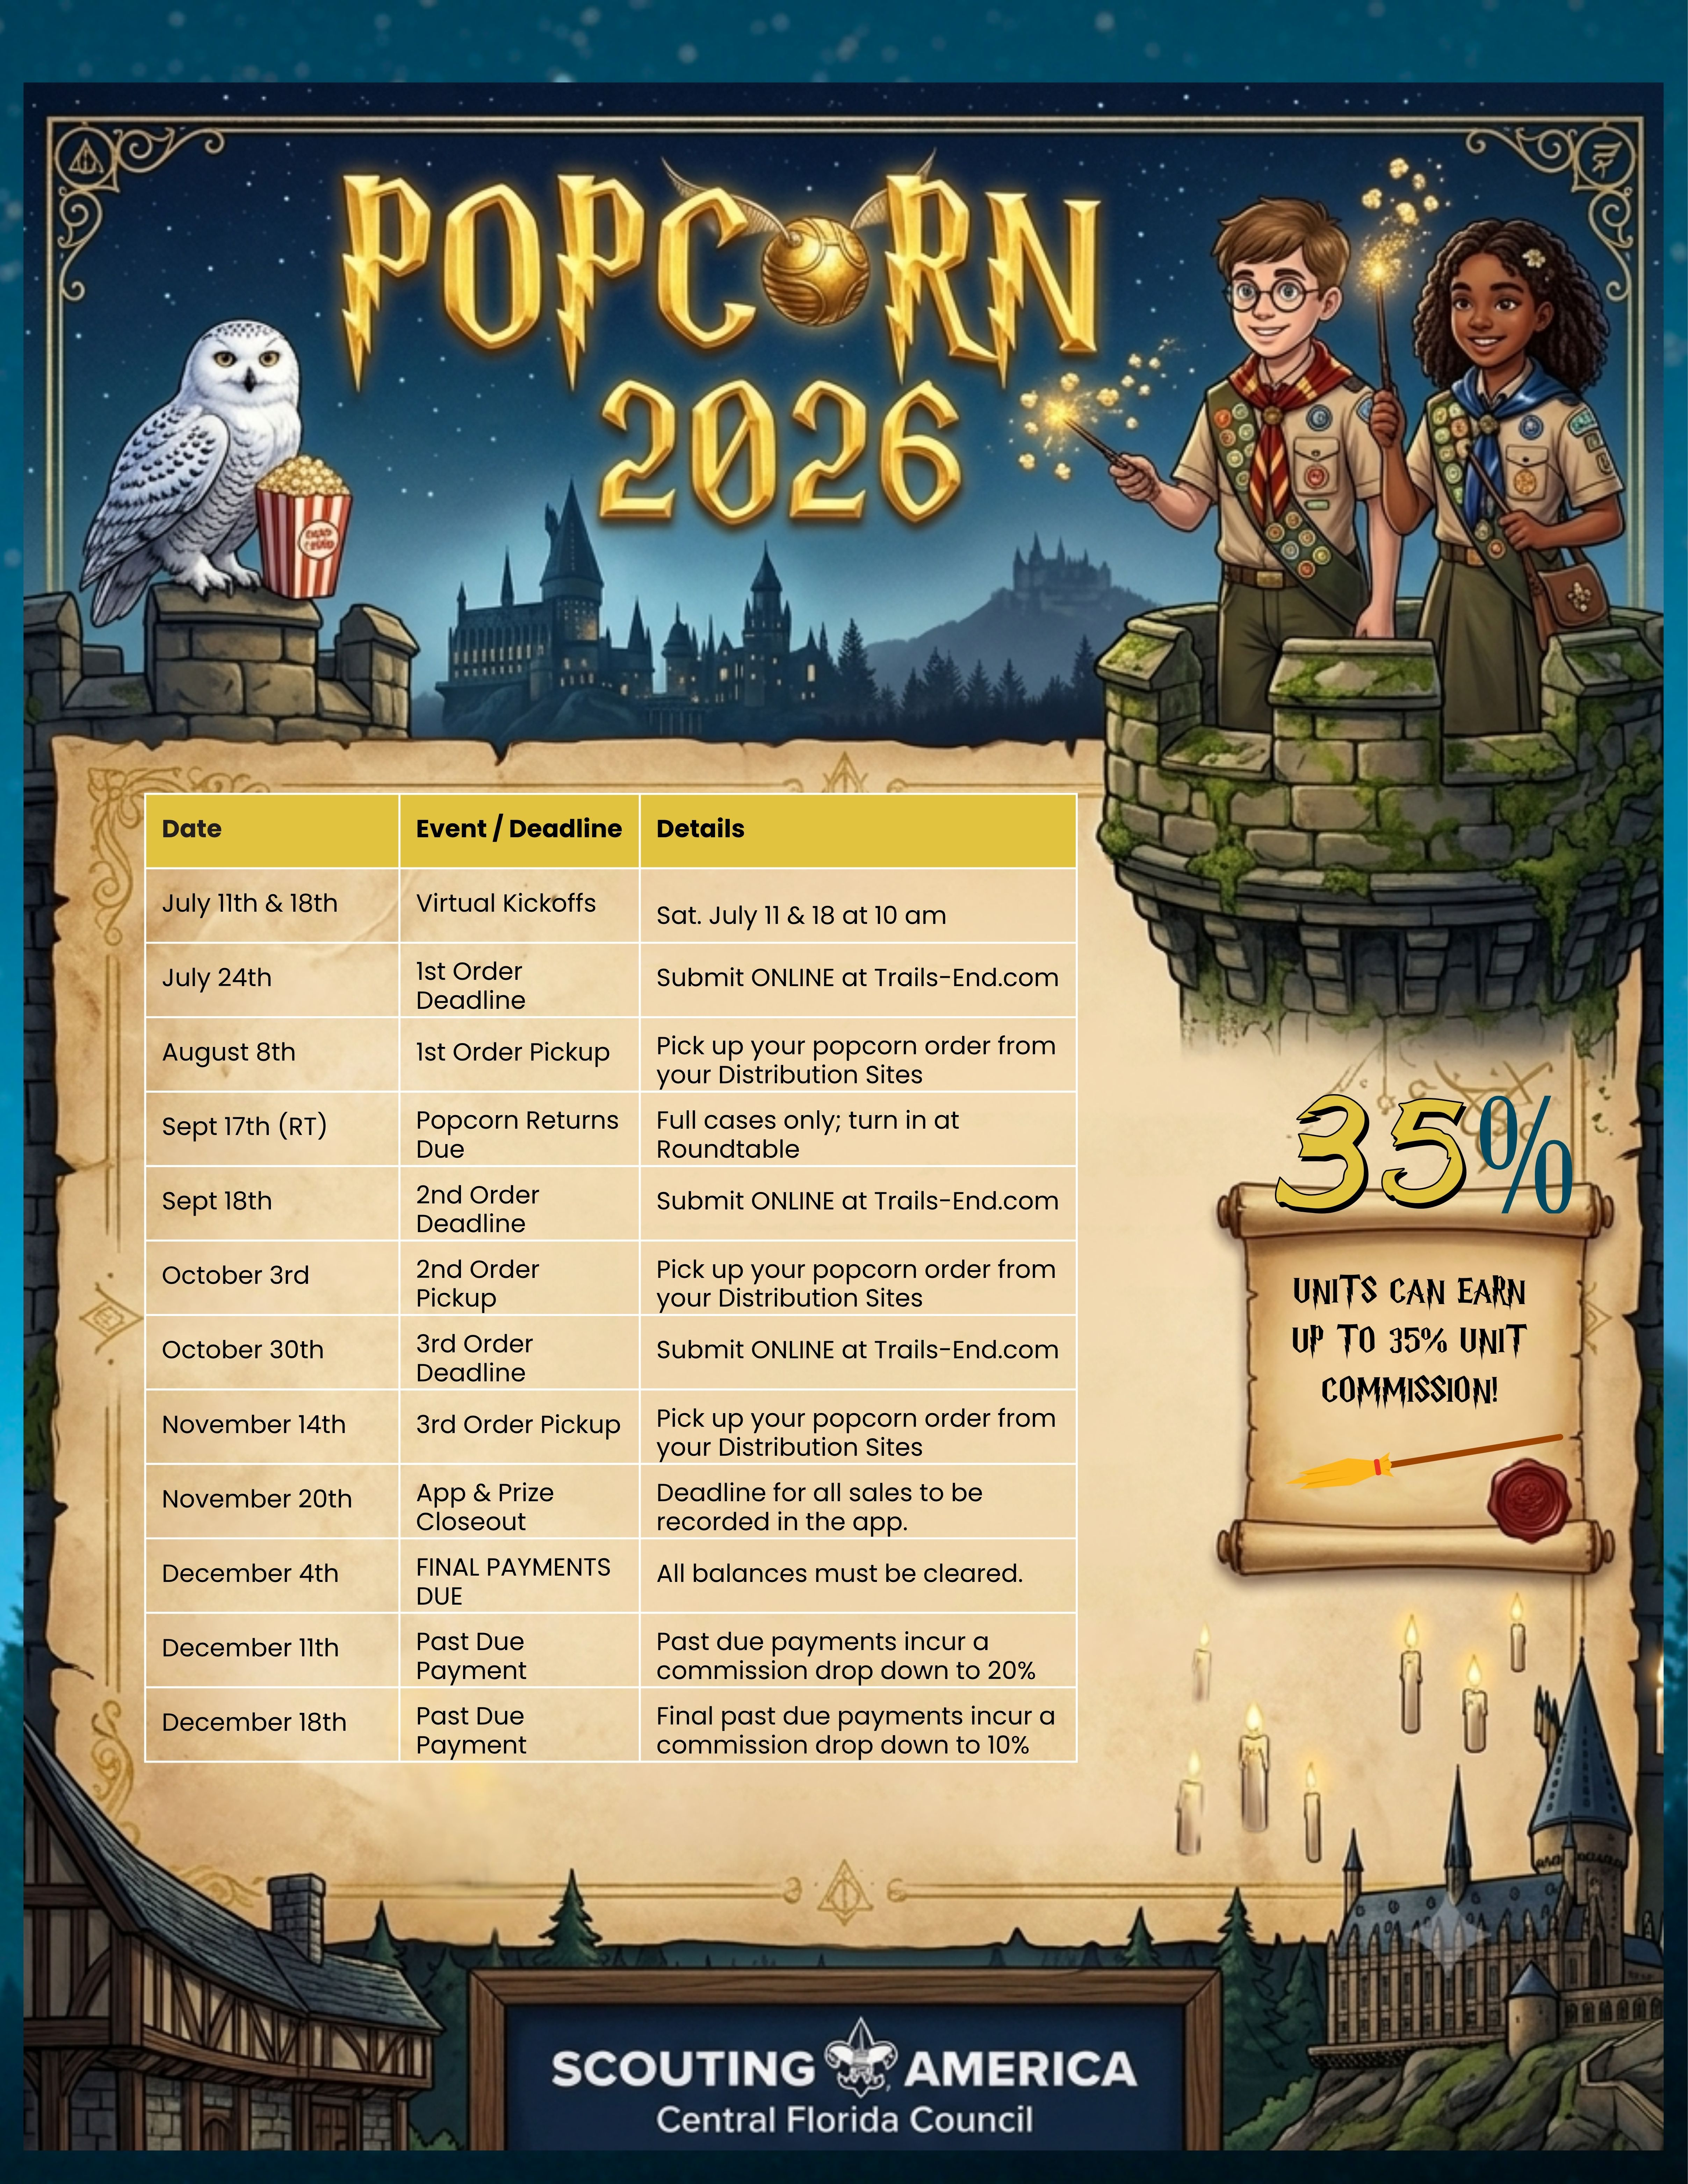

July Calendar Updates:

Slide 21
August & September
Calendar Updates:

Slide 22
October & November
Calendar Updates:

Slide 23
December Calendar Updates:

Slide 24
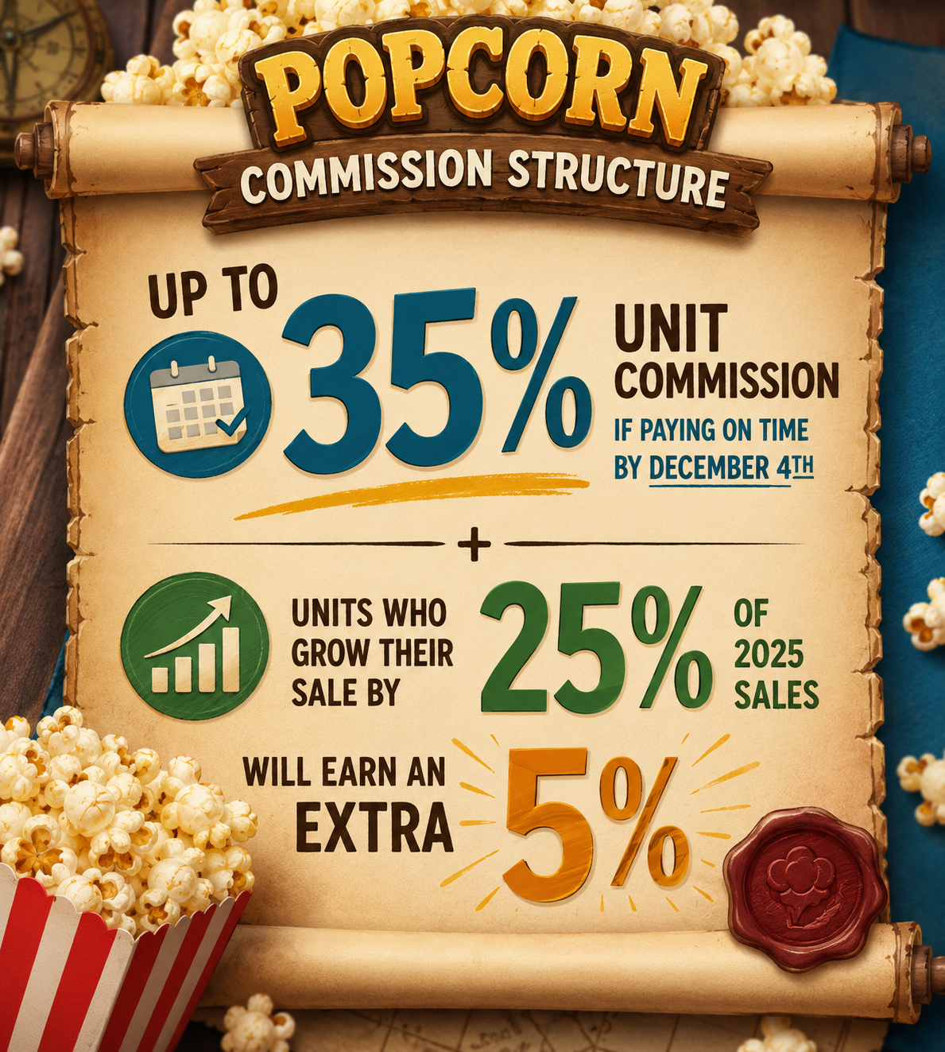

Slide 25
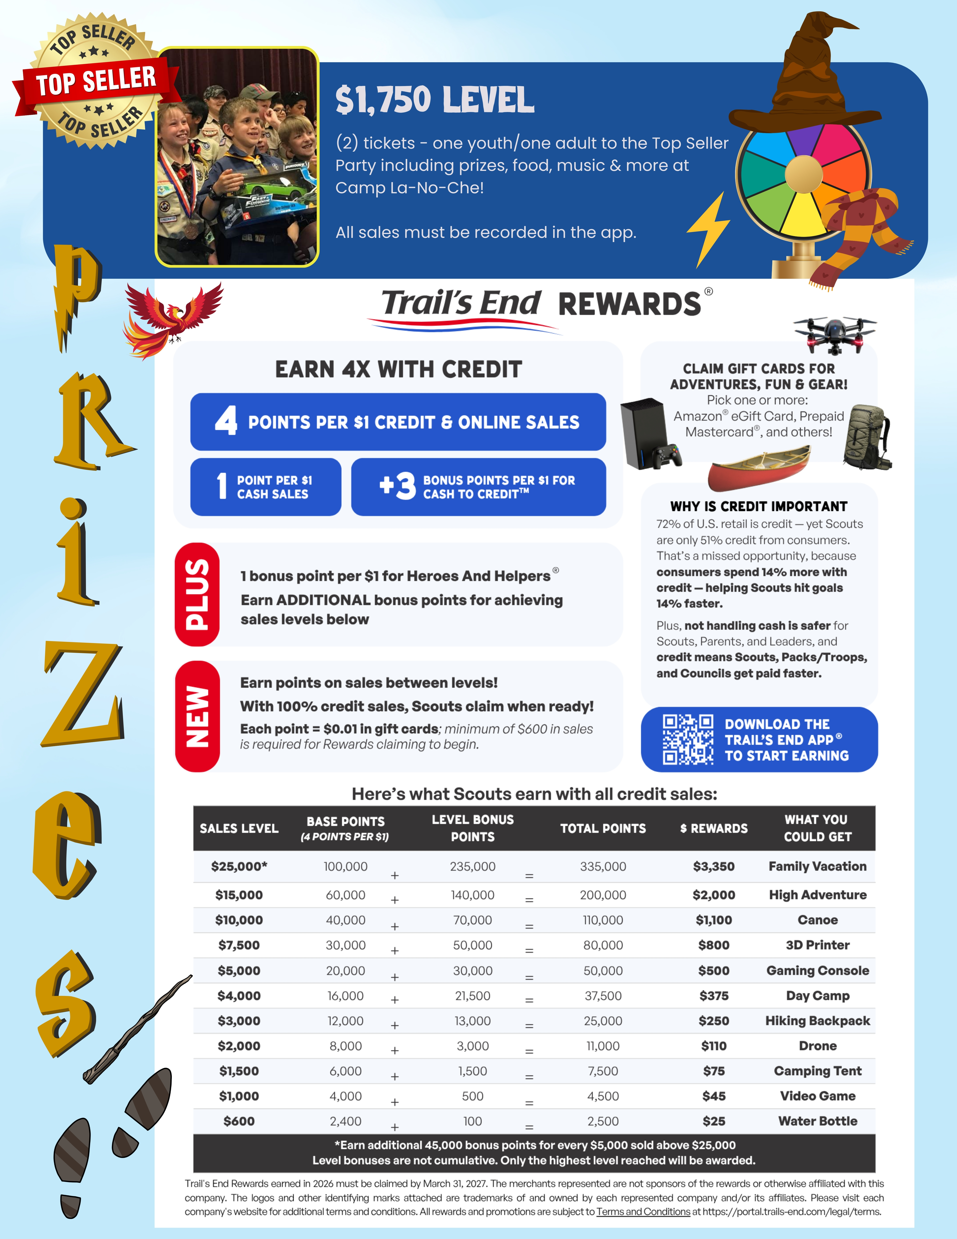
187 Scouts earned the Top Seller Party in 2025!
Exciting Top 25
Scout Incentives!

Slide 26
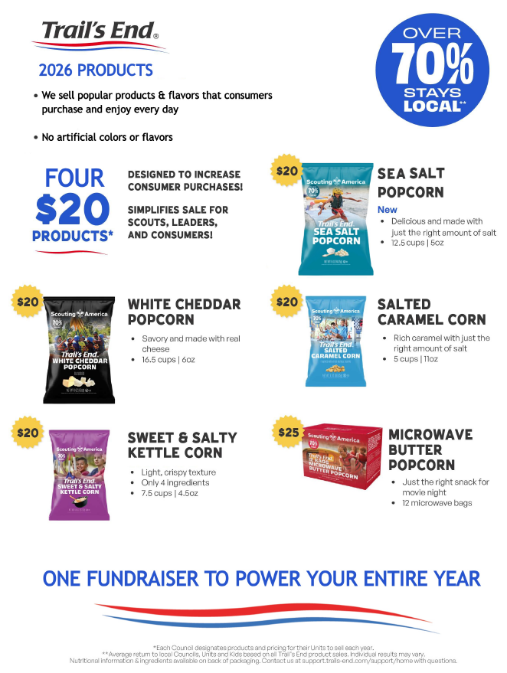
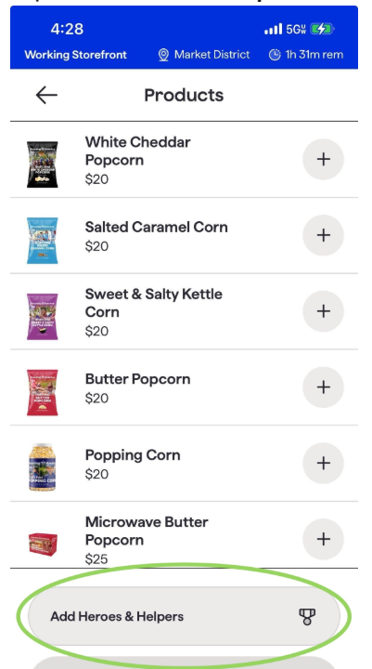


Slide 27
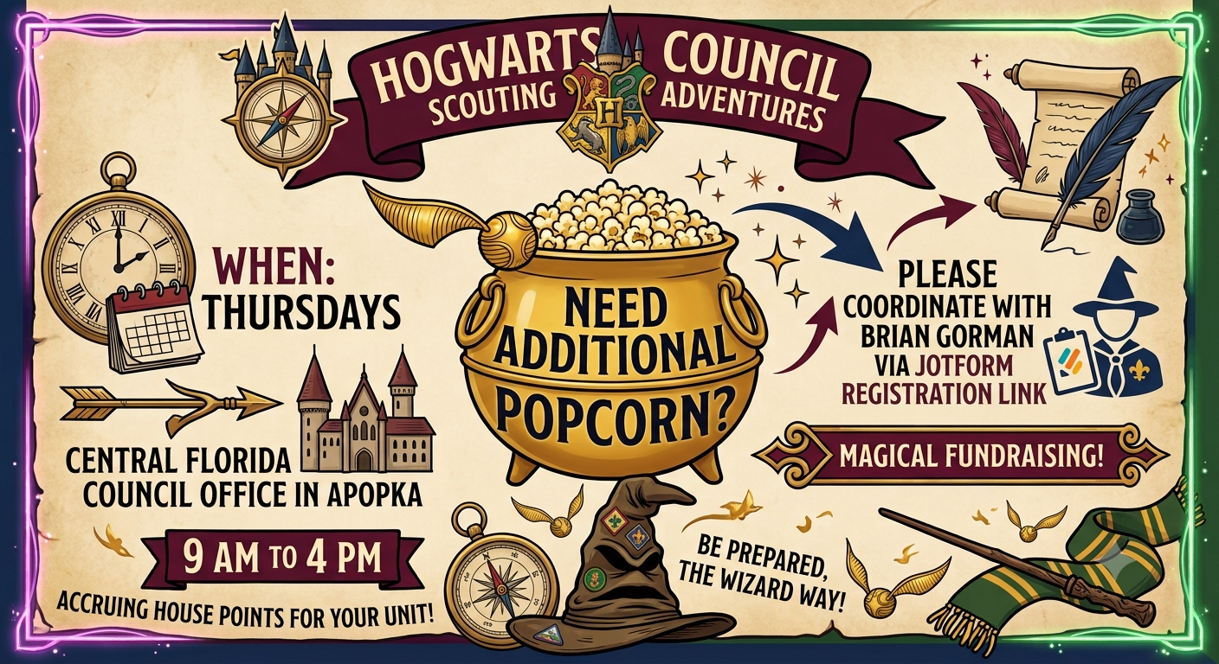
Order the popcorn you need in your 1st popcorn order

Slide 28
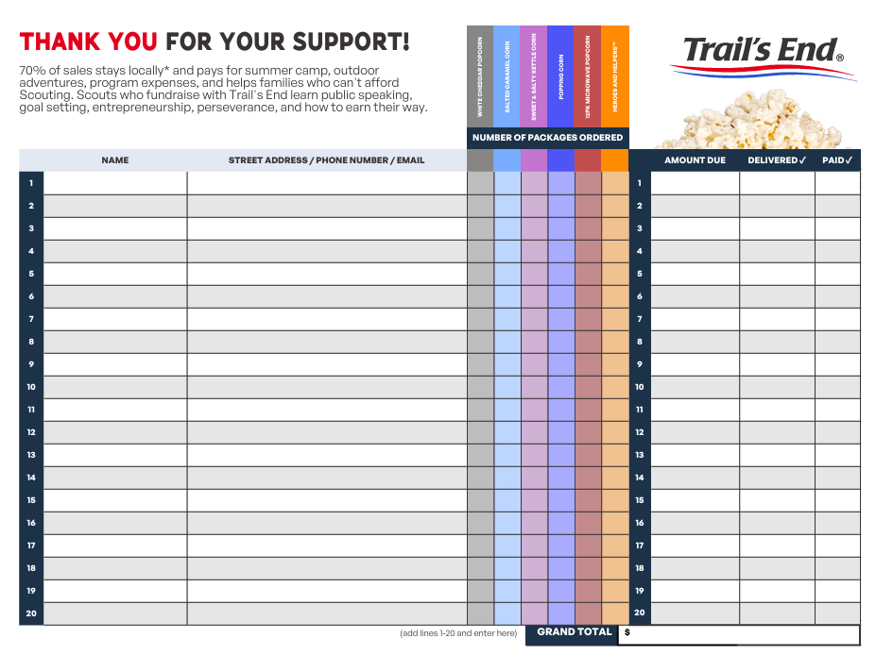
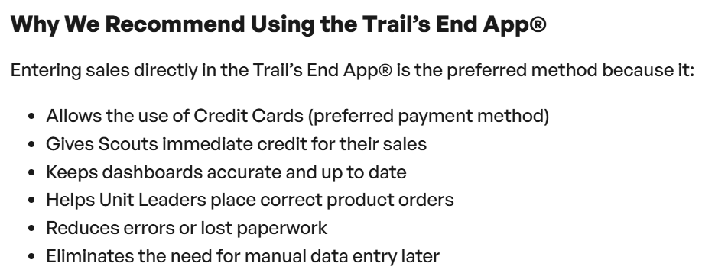
Popcorn Take Order Forms will be available online.

Slide 29

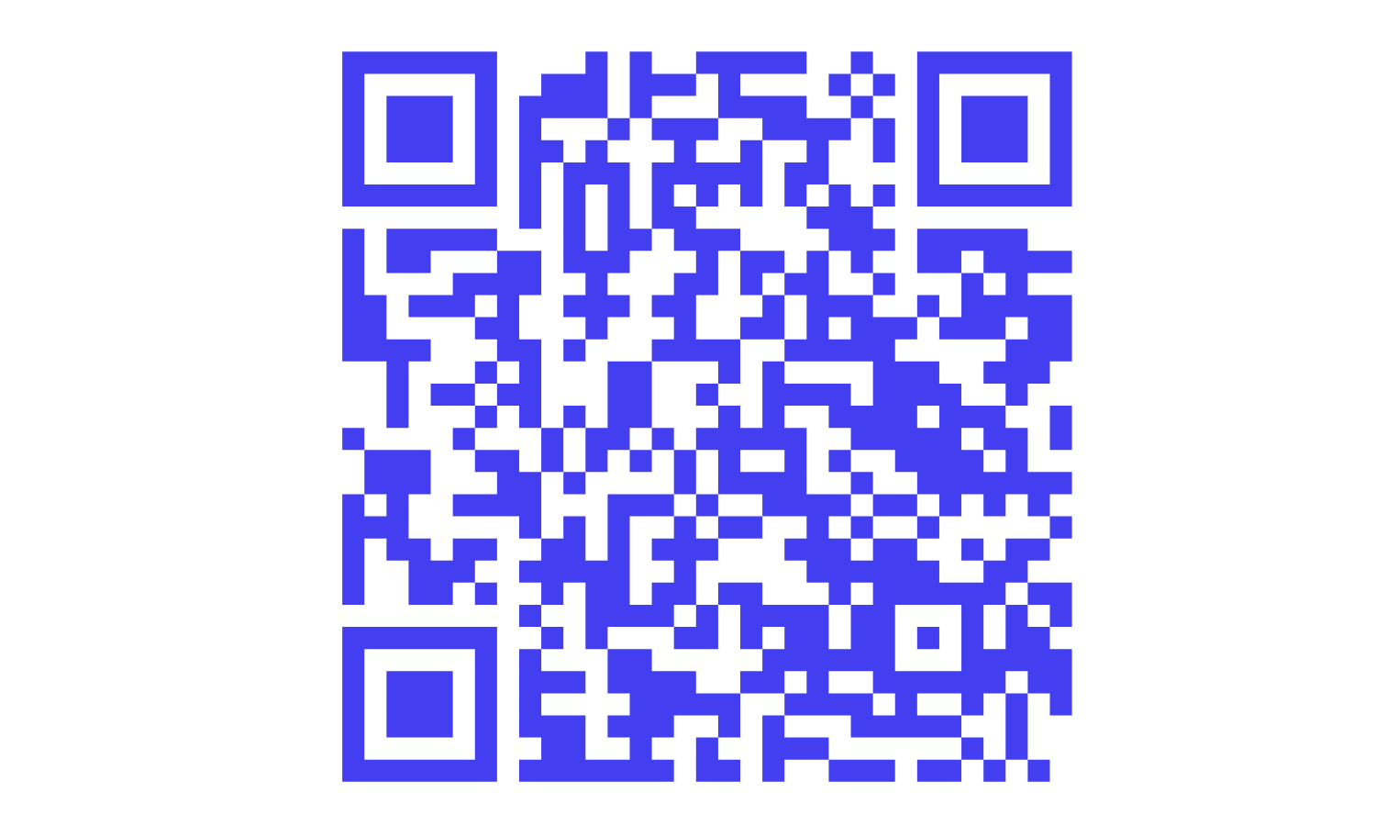

Join Today!
Share your successes!

Slide 30


